Slide 1
Applications of Graphs
Name: Aarohi Bhand
Roll no: 222007
GR No.: 22010494

Slide 2
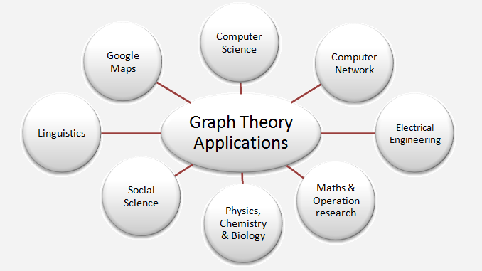

Slide 3
In Computer Science
In computer science graph theory is used for the study of algorithms like:
Dijkstra's Algorithm
Prims's Algorithm
Kruskal's Algorithm
Graphs are used to define the flow of computation.
Graphs are used to represent networks of communication.
Graphs are used to represent data organization.
In Google Maps, various locations are represented as vertices or nodes and the roads are represented as edges and graph theory is used to find the shortest path between two nodes.

Slide 4
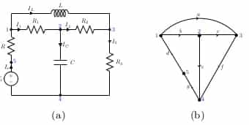
Electrical Engineering
In Electrical Engineering, graph theory is used in designing of circuit connections. These circuit connections are named as topologies. Some topologies are series, bridge, star and parallel topologies.

Slide 5
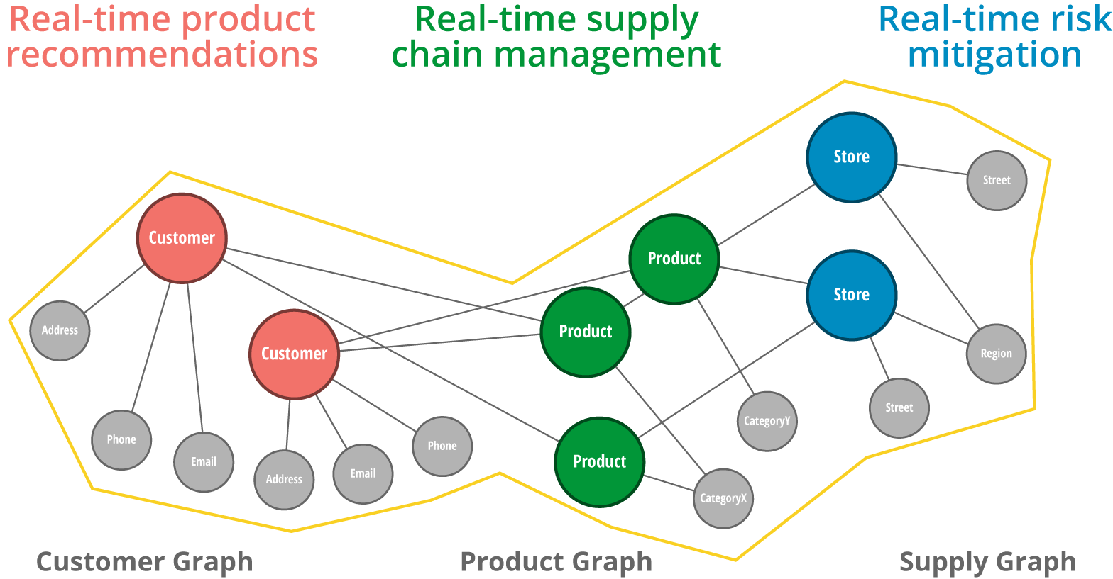
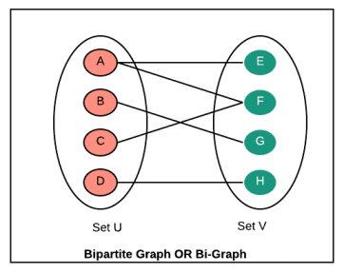
Product recommendation
If you buy a product, Amazon recommends you buying similar products. These recommended products are based on what other users have already bought. For example, you buy a book about Python; Amazon recommends you to buy a book about Scrum. At the heart of these systems are huge bipartite graphs.

Slide 6
Computer Network
In computer network, the relationships among interconnected computers within the network, follow the principles of graph theory.
Graph theory is also used in network security.
We can use the vertex coloring algorithm to find a proper coloring of the map with four colors.
Vertex coloring algorithm may be used for assigning at most four different frequencies for any GSM (Grouped Special Mobile) mobile phone networks.

Slide 7
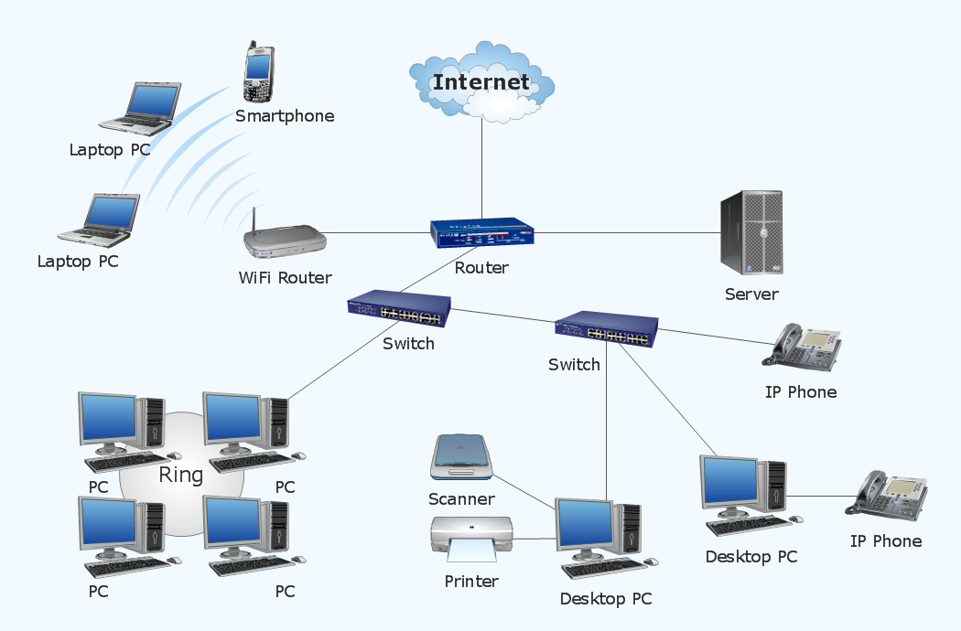
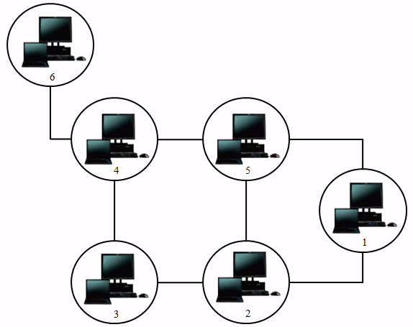

Slide 8
Social Sciences
Graph theory is also used in sociology. For example, to explore rumor spreading, or to measure actors' prestige notably through the use of social network analysis software.
Acquaintanceship and friendship graphs describe whether people know each other or not.
In influence graphs model, certain people can influence the behavior of others.
In collaboration graphs model to check whether two people work together in a particular way, such as acting in a movie together.

Slide 9
General Applications
Used in social networks such as Facebook and Linkedin.
Operating Systems use Resource Allocation Graph where every process and resource acts as a node while edges are drawn from resources to the allocated process.
Used in the world wide web where the web pages represent the nodes.
Blockchains also use graphs. The nodes are blocks that store many transactions while the edges connect subsequent blocks.
Used in modeling data.

Slide 10
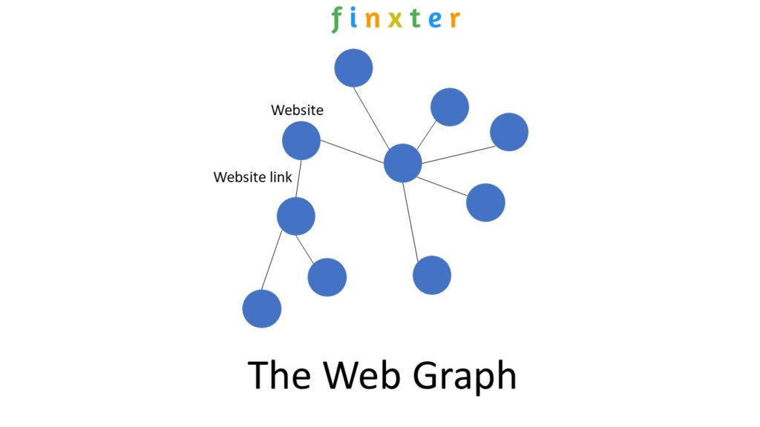
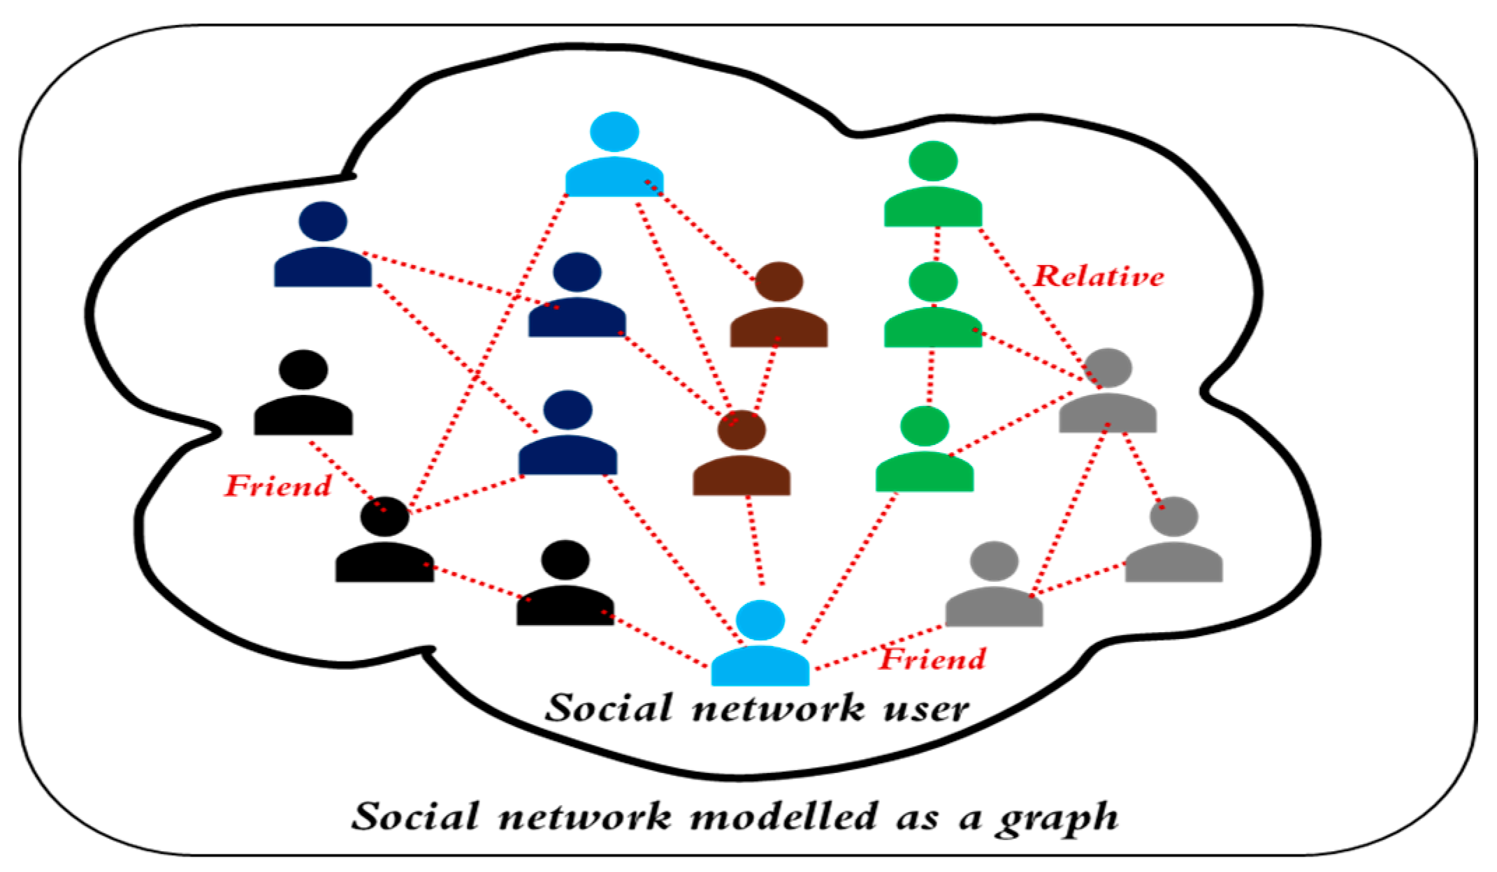
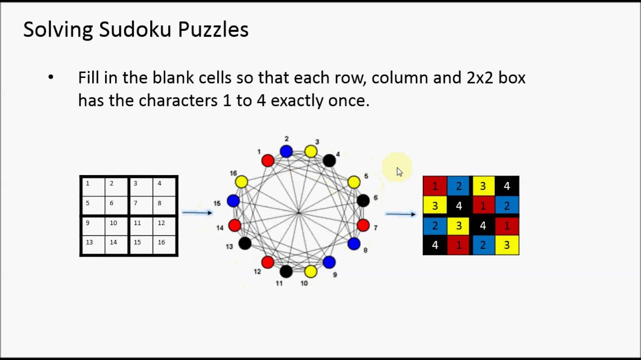
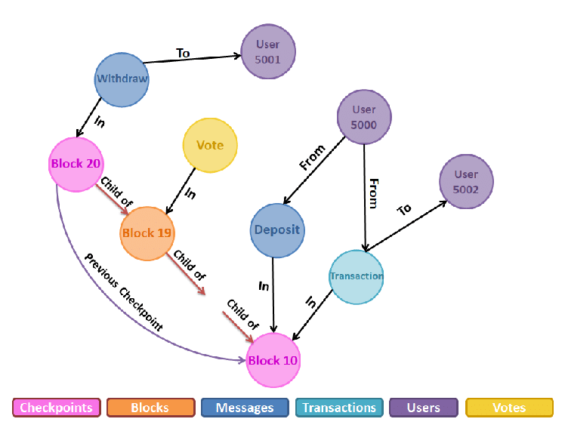

Slide 11
THANK YOU

